Slide 1


Tweets & Text Classification using machine learning
Final presentation

Slide 2
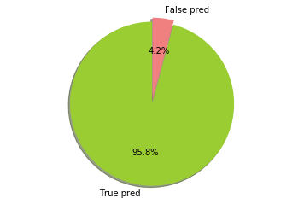
ACCURACY: 95.8% CoutVectorizer with n-grams
Positive/Negative Classification

Slide 3
More than two classifications
business
entertainment
health
politics
sports
technology

Slide 4
Data collection
Dataset: Kaggle Competition Text Categorization Dataset “JSON and CSV format”
Key Characteristics of the data set
It contains headlines and categories for 350,000 news Headlines & short Articles
There are 60000 news of business category, 70000 news of technology category, 80000 news of entertainment category, 60000 news of health category, 45000 news of Politics category, 40000 news of Sports category
Some Online New papers “BBC & Times & yahoo Sports”

Slide 5
Split the data to train and test sets
Make a module for each class

Slide 6
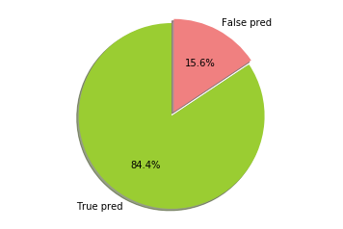
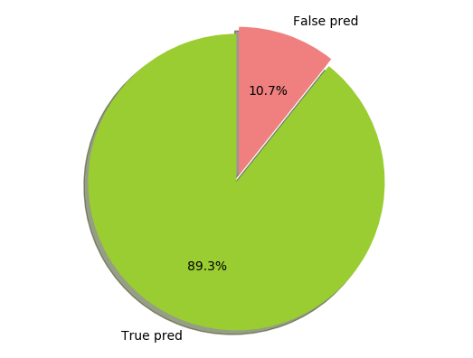
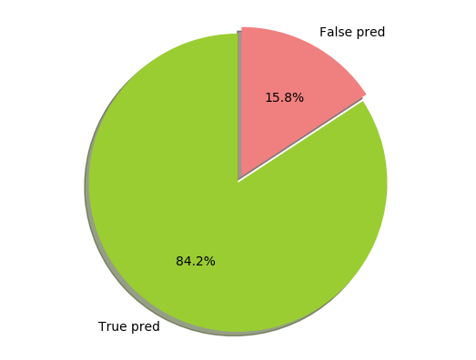
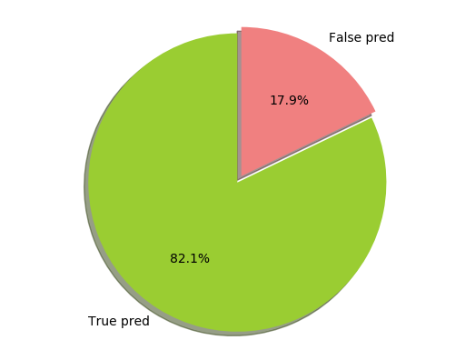

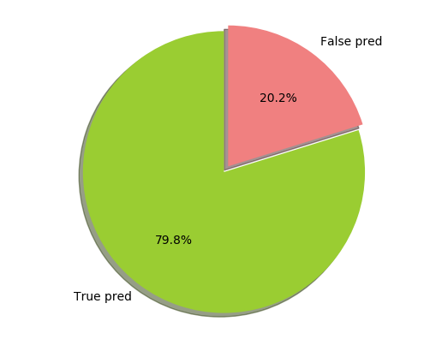
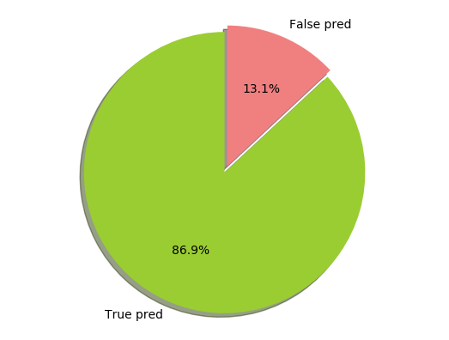
Testing results using different classifiers
Logistic Regression classifier

Slide 7
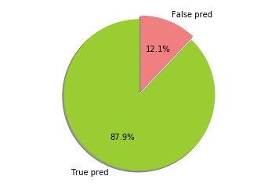
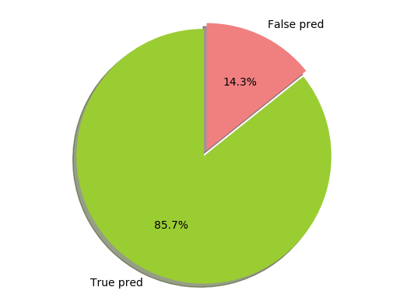


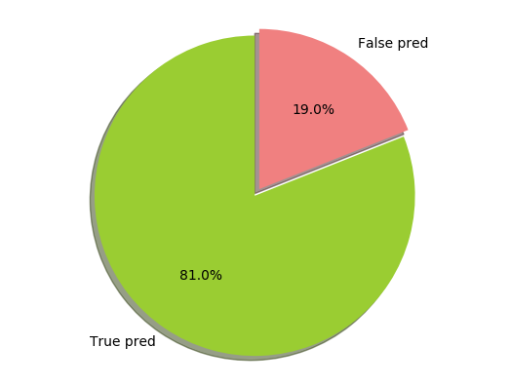
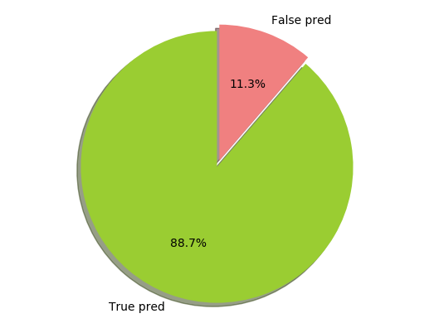
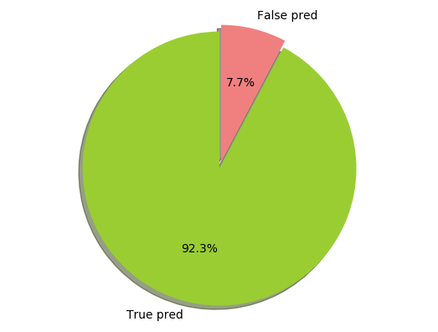
Extra Trees
Overall

Slide 8
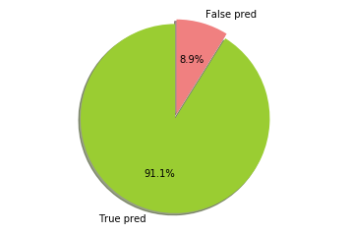
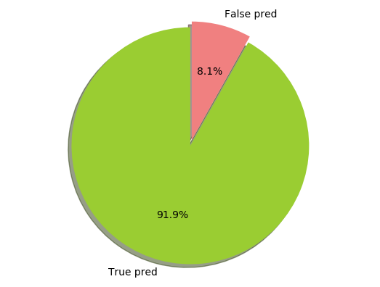
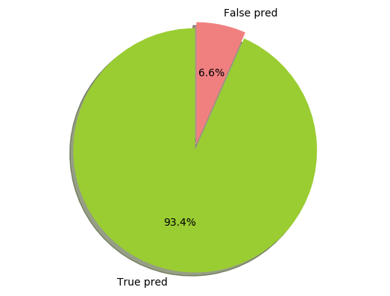



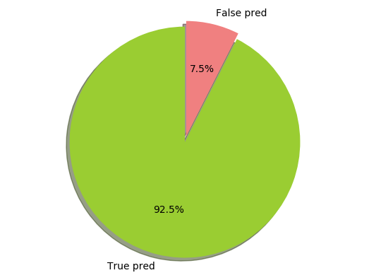
Decision Tree
Overall

Slide 9
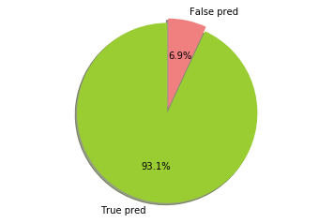
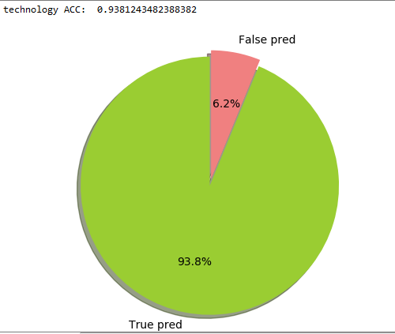
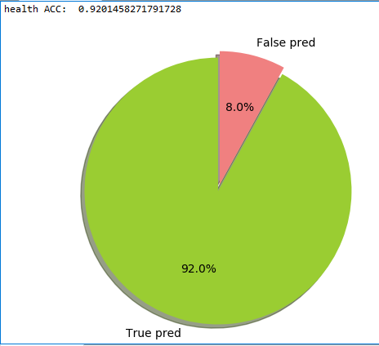
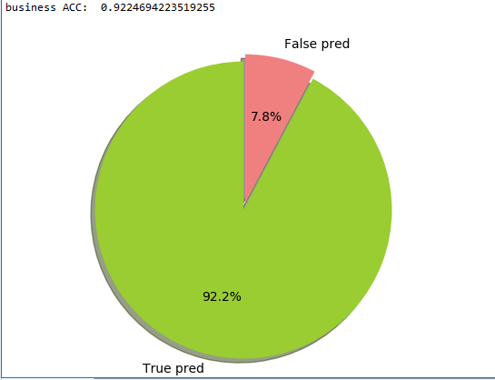
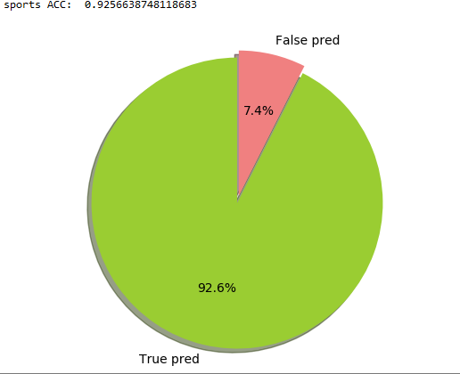
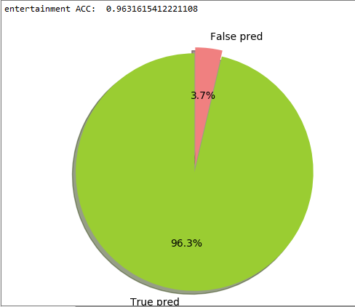
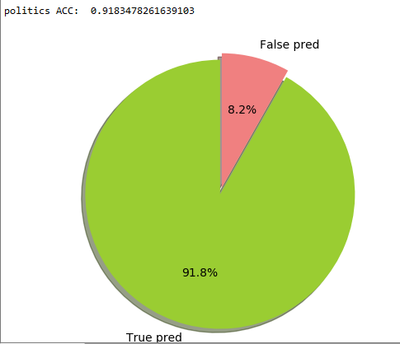
KNN (K-Nearest Neighbor )
overall

Slide 10

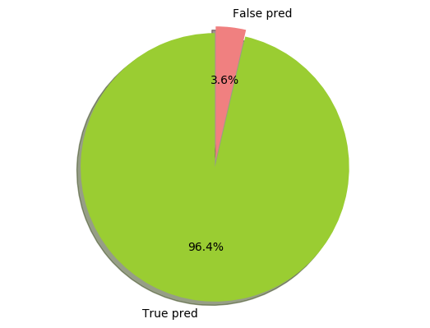
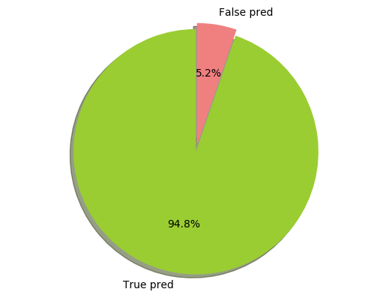

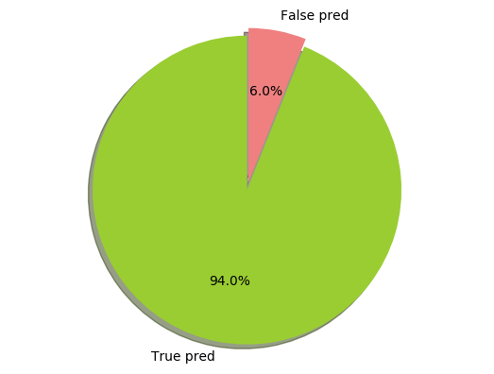

MLP Multi layer perceptron
Overall

Slide 11
Best classifier
MLP classifier method gave the best results

Slide 12
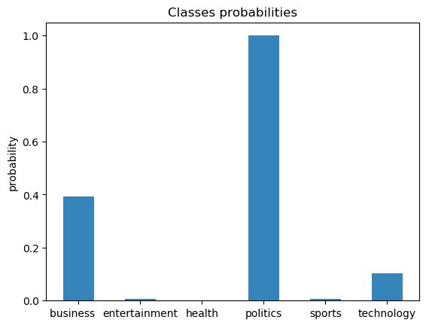
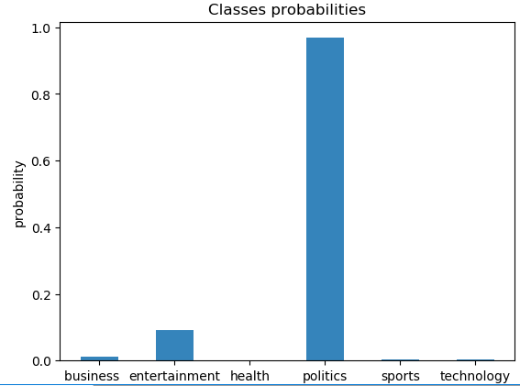
Predict: ( The presidential elections will held in this month )
Before
After

Slide 13

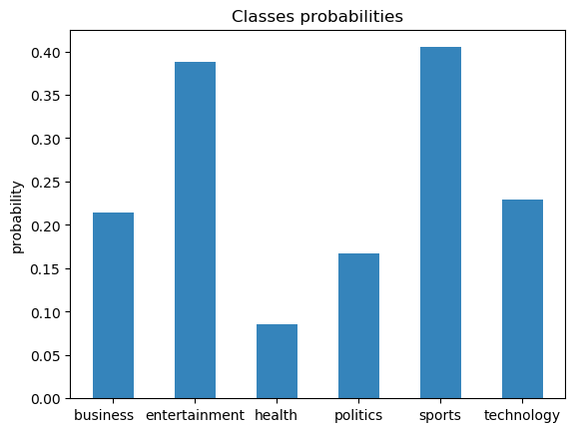
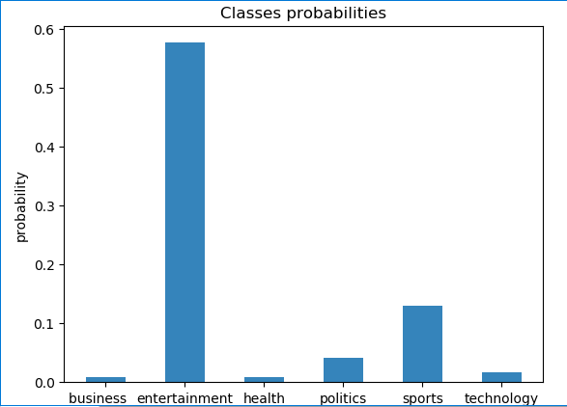
Errors:
OLD
n
NEW

Slide 14

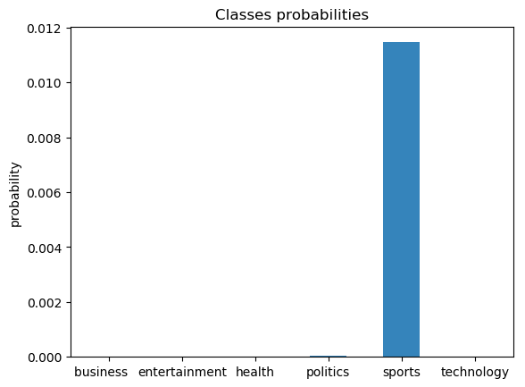
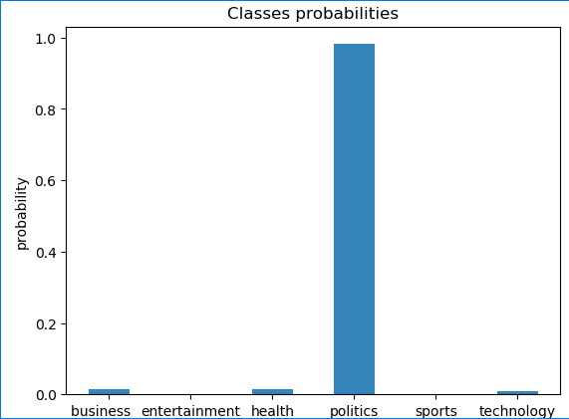
Testing (politics) fixing the error

Slide 15

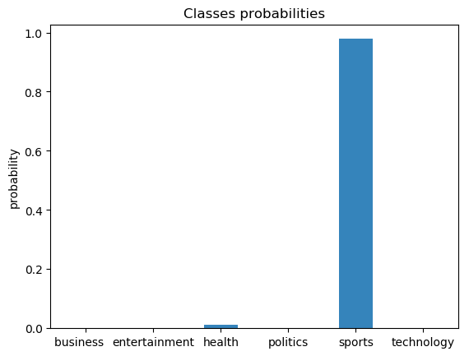
Testing (sports)

Slide 16

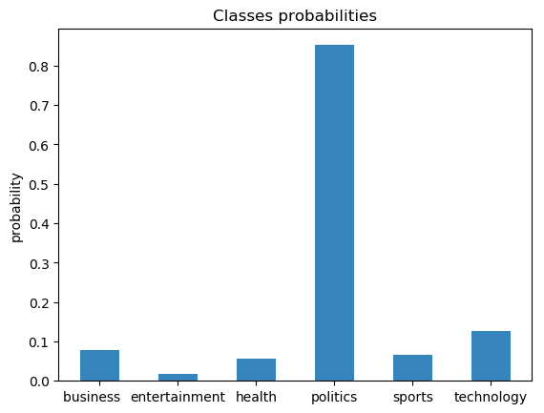
Predicted result should be (politics)

Slide 17

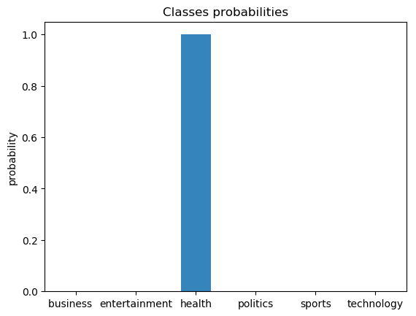
Testing (health)

Slide 18

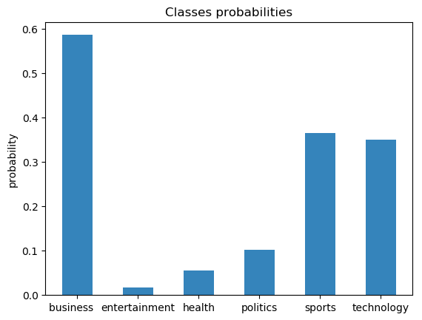
Testing (business)

Slide 19

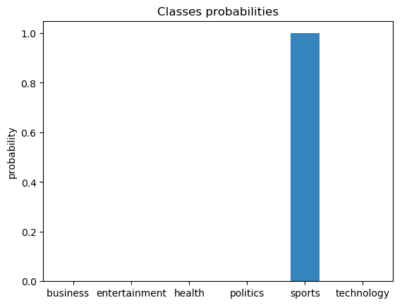
Testing (sports)

Slide 20


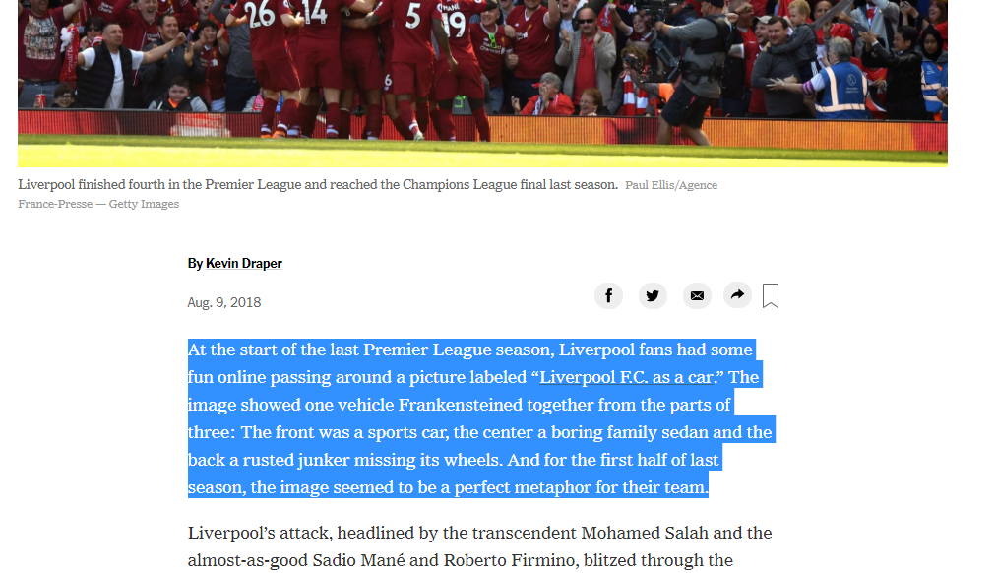
Testing (sports)

Slide 21

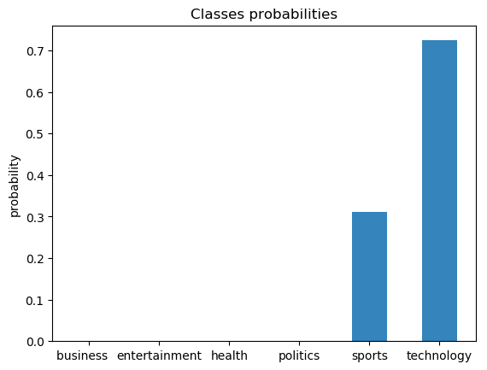
Testing (technology)

Slide 22

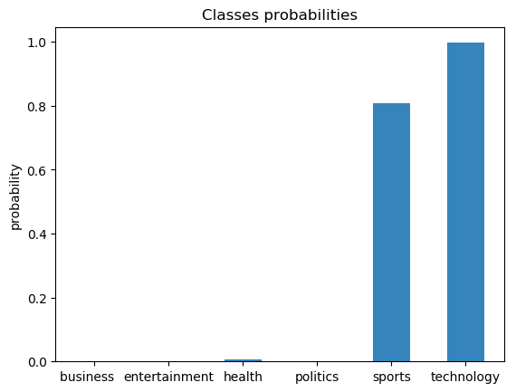
Testing (technology)

Slide 23

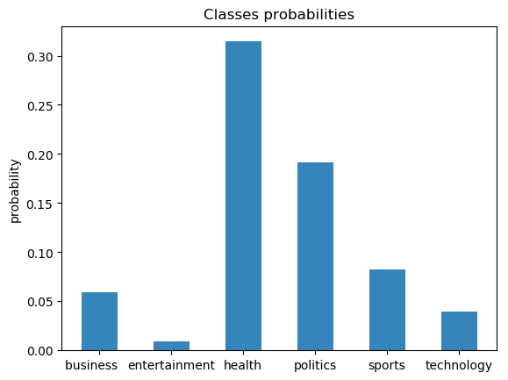
Testing (health)

Slide 24
MLP
A multilayer perceptron (MLP) is a class of feedforward artificial neural network. An MLP consists of at least three layers of nodes. Except for the input nodes, each node is a neuron that uses a nonlinear activation function. MLP utilizes a supervised learning technique called backpropagation for training . Its multiple layers and non-linear activation distinguish MLP from a linear perceptron. It can distinguish data that is not linearly separable.
Drawback: slow

Slide 25
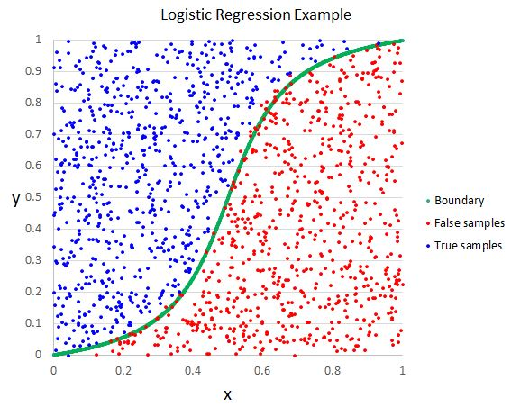
logistic regression
logistic regression is estimating the parameters of a logistic model. More formally, a logistic model is one where the log-odds of the probability of an event is a linear combination of independent or predictor variables. The two possible dependent variable values are often labelled as "0" and "1", which represent outcomes such as pass/fail, win/lose, alive/dead or healthy/sick. The binary logistic regression model can be generalized to more than two levels of the dependent variable: categorical outputs with more than two values are modelled by multinomial logistic regression, and if the multiple categories are ordered, by ordinal logistic regression, for example the proportional odds ordinal logistic model.

Slide 26
Extra trees
The Extra-Tree method (standing for extremely randomized trees) with the main objective of further randomizing tree building in the context of numerical input features, where the choice of the optimal cut-point is responsible for a large proportion of the variance of the induced tree.
With respect to random forests, the method drops the idea of using bootstrap copies of the learning sample, and instead of trying to find an optimal cut-point for each one of the K randomly chosen features at each node, it selects a cut-point at random.
This idea is rather productive in the context of many problems characterized by a large number of numerical features varying more or less continuously: it leads often to increased accuracy thanks to its smoothing and at the same time significantly reduces computational burdens linked to the determination of optimal cut-points in standard trees and in random forests.
From a statistical point of view, dropping the bootstrapping idea leads to an advantage in terms of bias, whereas the cut-point randomization has often an excellent variance reduction effect. This method has yielded state-of-the-art results in several high-dimensional complex problems.
From a functional point of view, the Extra-Tree method produces piece-wise multilinear approximations, rather than the piece-wise constant ones of random forests.
Summary: make a lot of decision trees and select the best.

Slide 27

Decision Tree
Decision tree learning uses a decision tree (as a predictive model) to go from observations about an item (represented in the branches) to conclusions about the item's target value (represented in the leaves). It is one of the predictive modelling approaches used in statistics, data mining and machine learning. Tree models where the target variable can take a discrete set of values are called classification trees; in these tree structures, leaves represent class labels and branches represent conjunctions of features that lead to those class labels. Decision trees where the target variable can take continuous values (typically real numbers) are called regression trees.

Slide 28
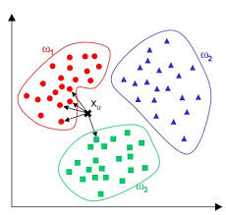
knn
* In k-NN classification, the output is a class membership. An object is classified by a majority vote of its neighbors, with the object being assigned to the class most common among its k nearest neighbors (k is a positive integer, typically small). If k = 1, then the object is simply assigned to the class of that single nearest neighbor.
* In k-NN regression, the output is the property value for the object. This value is the average of the values of its k nearest neighbors.

Slide 29
*Code

Slide 30
END

